Slide 1



How InfoSec provided Booster Rockets for Walmart Labs Agile Transformation
Julie Tsai, Agile InfoSec Leader, Walmart GeC
Kamal Manglani, Agile Lead, Walmart GeC
Walmart Global eCommerce Group Confidential

Slide 2

InfoSec Agile Overview
The Shift in Mindset
InfoSec Product Management
Visibility of Work
Developing Mavens across the Org
Promoting Culture through
Industry Leaders
2

Slide 3
Rewind.. (# of Agile Teams)
250
130+
1
8
2012
Organization Goal
Setting 2012:
25% Agile Teams
1 internal coach
13 external coaches
3 internal coaches
Resistance:
Grassroots
Experiment
First Exec
Confidence
Agile Warp speed
Grassroots change
Agile Steering Group
2009
2011
2013
2014
Exciting but chaotic
Inspirational
Rip the Band-Aid
Agile is our Day Job
3

Slide 4
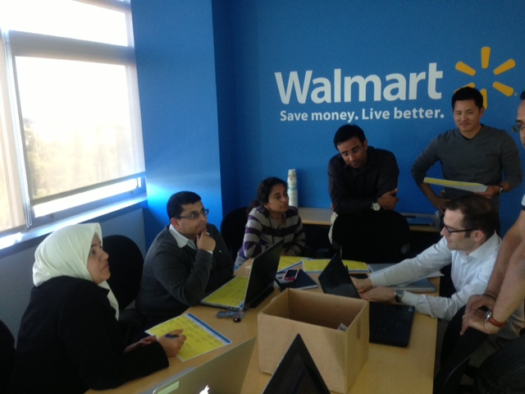
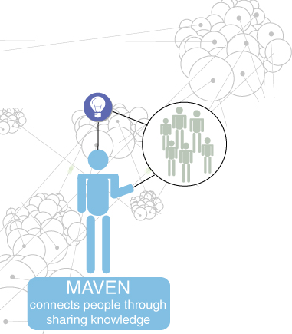
Security Maven Meeting / Offshoot Agile Steering Group
Associate Engagement Score (AES): Up by 27%.
50% plus teams on weekly or bi weekly release cycles (deployments)
20% of initiatives de-prioritized during release planning
Form communities for Agile Mindset (InfoSec – Mavens – the booster rocket)
4

Slide 5
Security MAVEN Role
A maven (also mavin) is a trusted expert in a particular field, who seeks to pass knowledge on to others.
Interest in security practices (No previous knowledge required)
Passion to mentor other coworkers to build a robust secure applications & infrastructure
Quality and Reliability focused

Slide 6
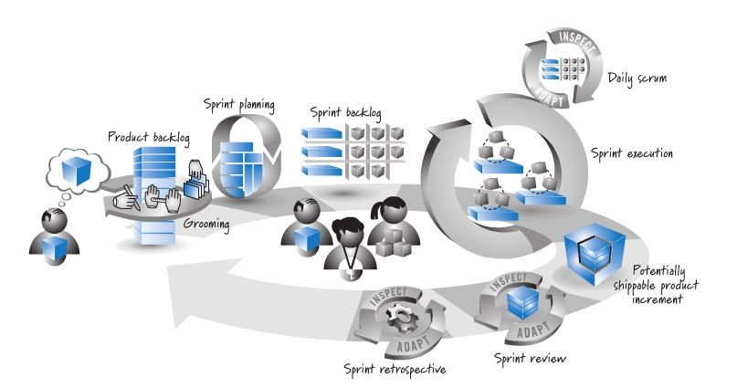
Definition for Agile at Walmart
Where is InfoSec?
Courtesy Ken Rubin
6

Slide 7

Definition for Agile at Walmart
InfoSec (Devops)
Mavens everywhere
Courtesy Ken Rubin
7

Slide 8
150 + Mavens and growing (10% of our engineering organization)
8

Slide 9
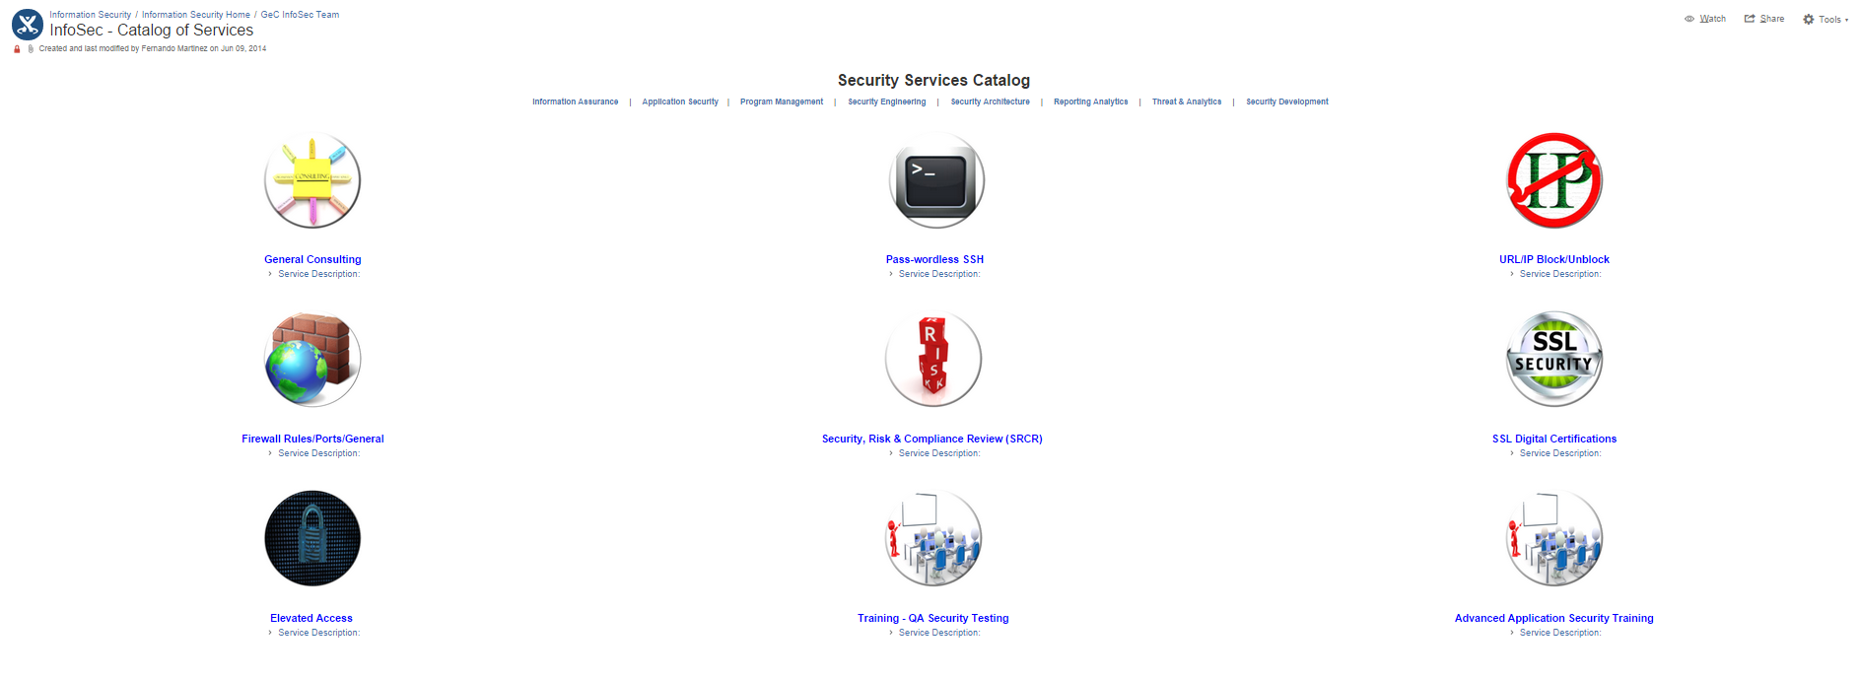
Visibility – Services & Metrics
9

Slide 10
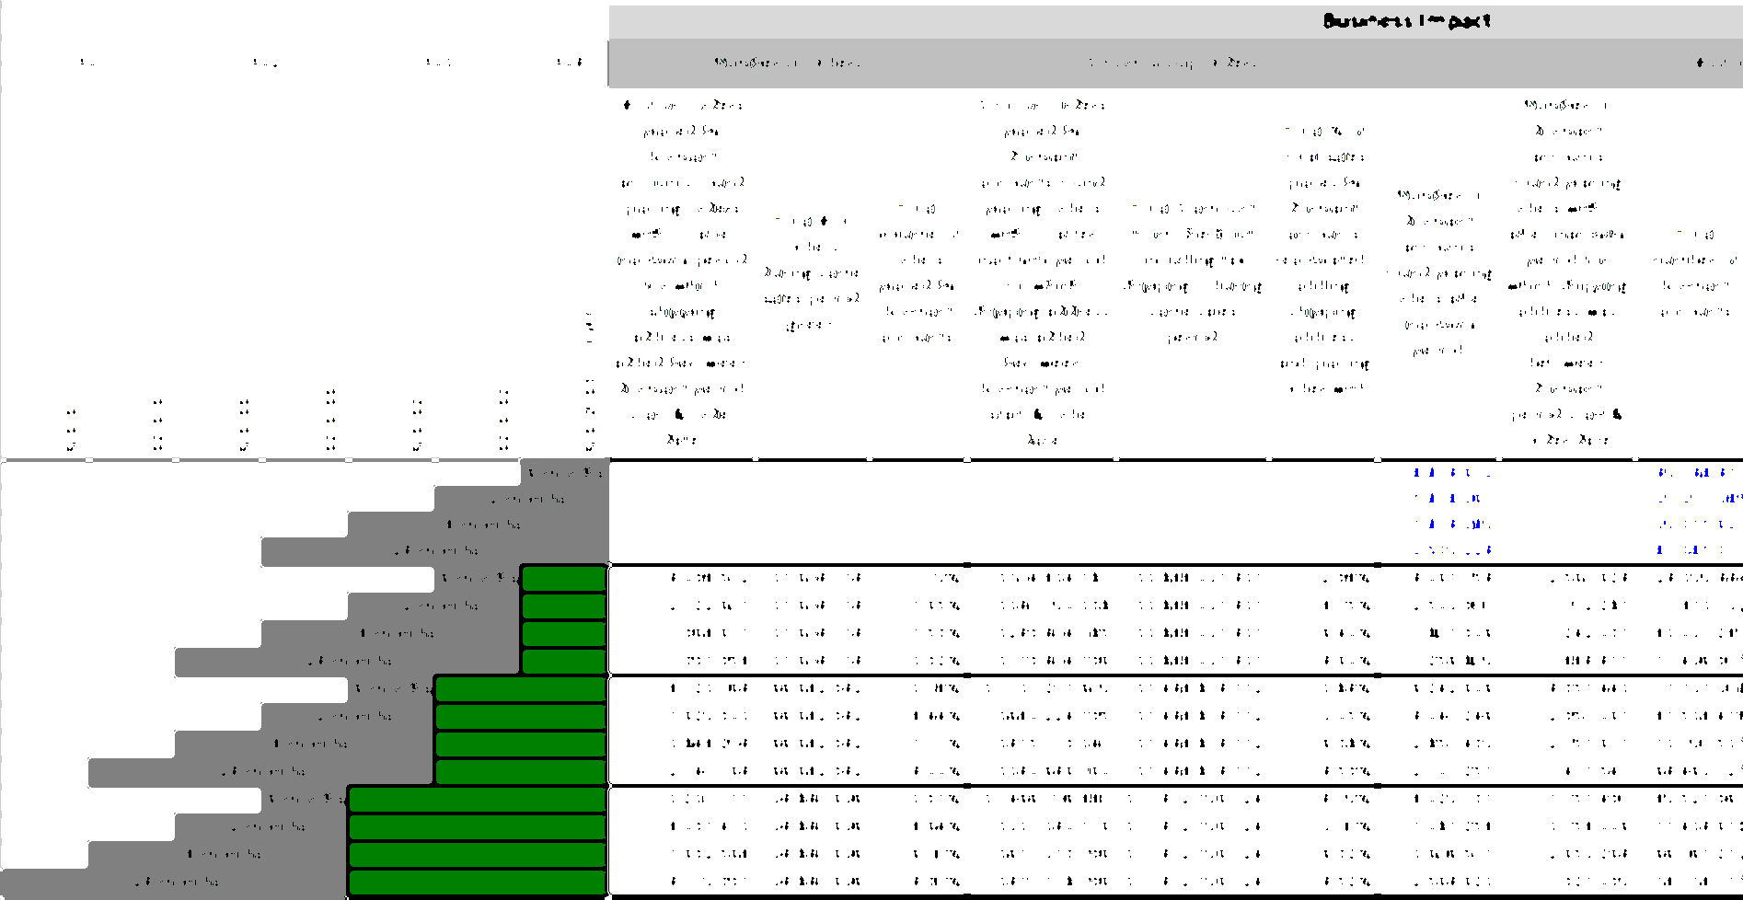
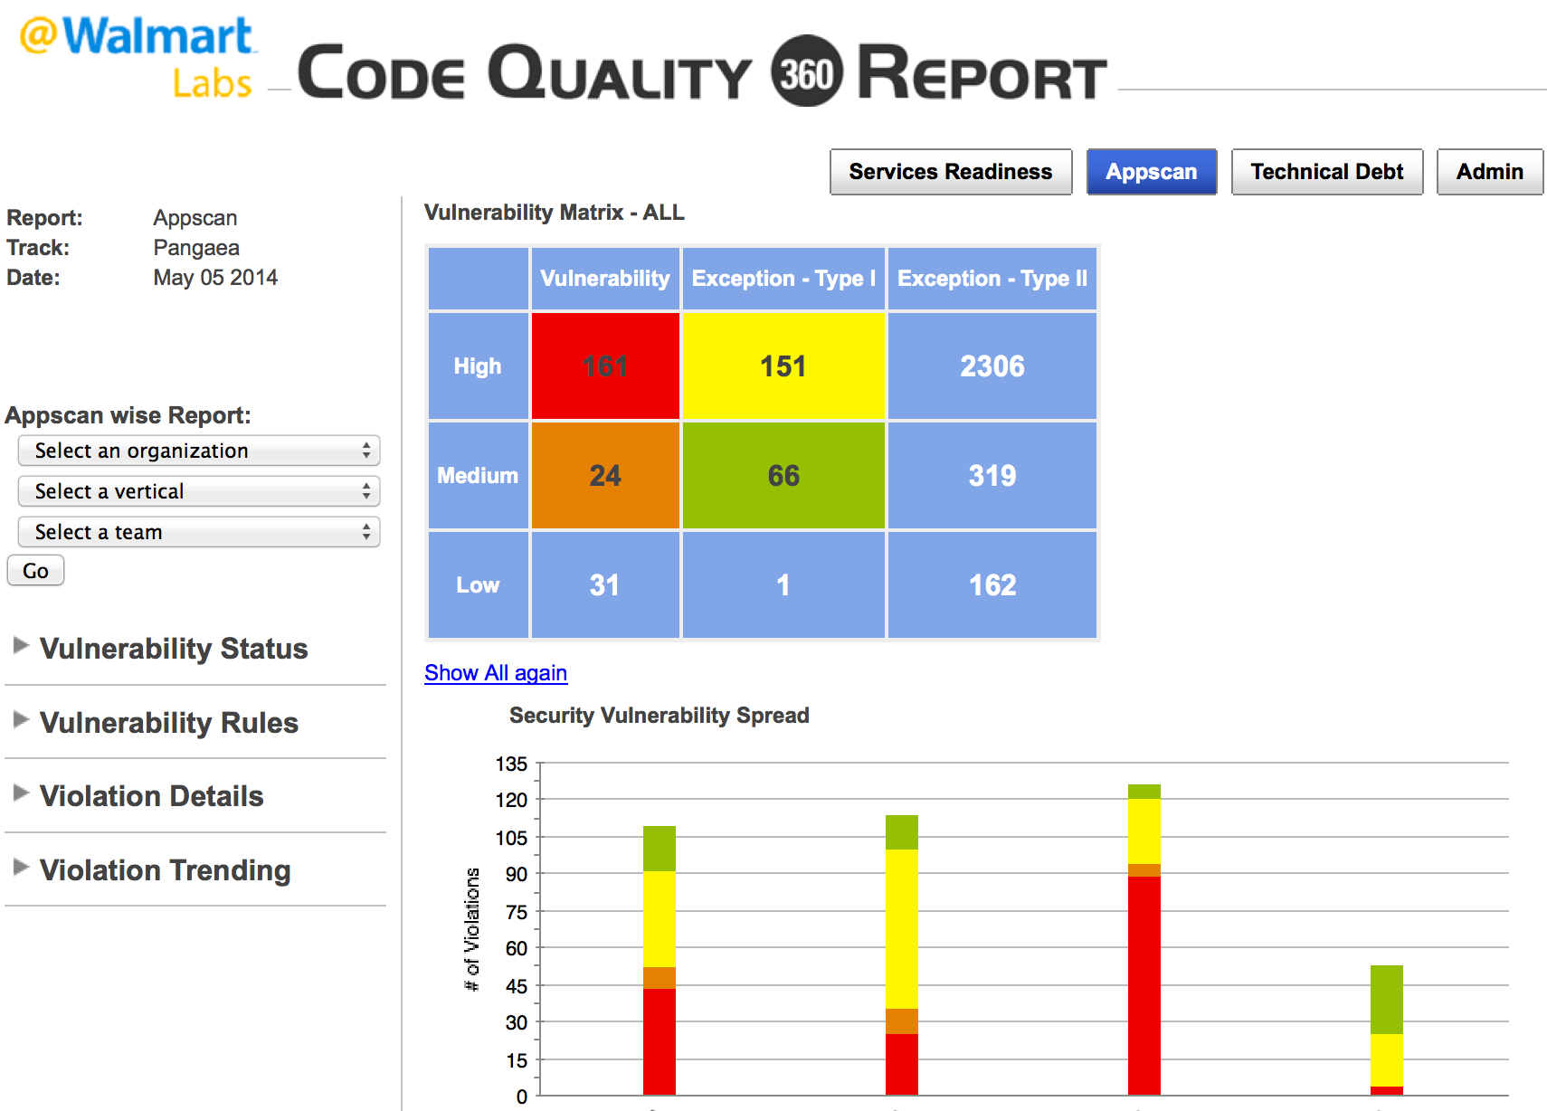

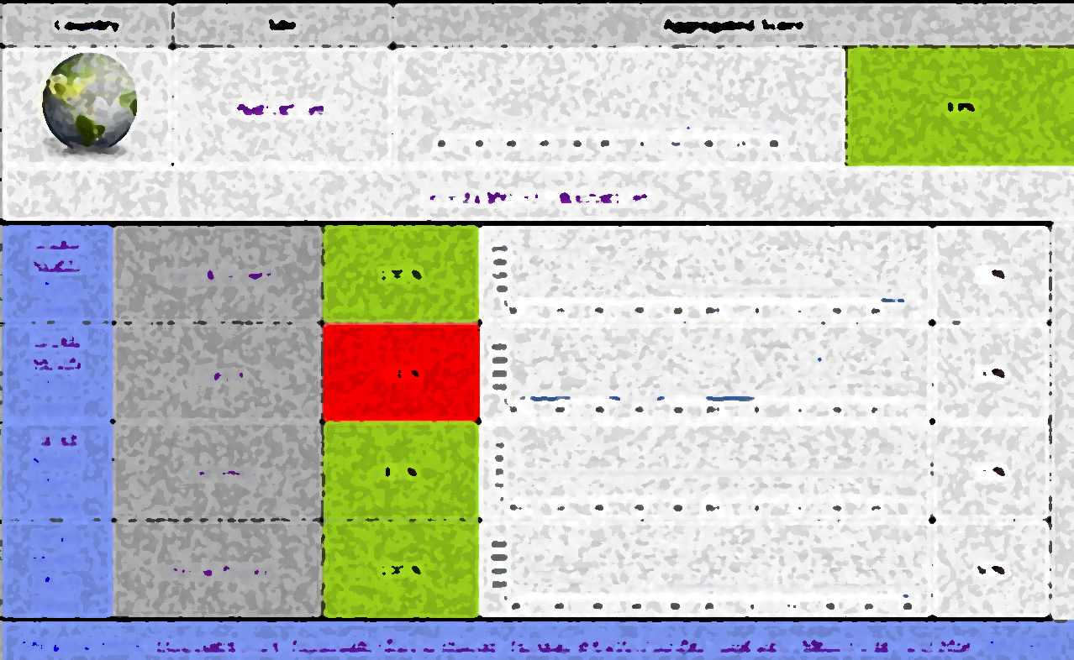
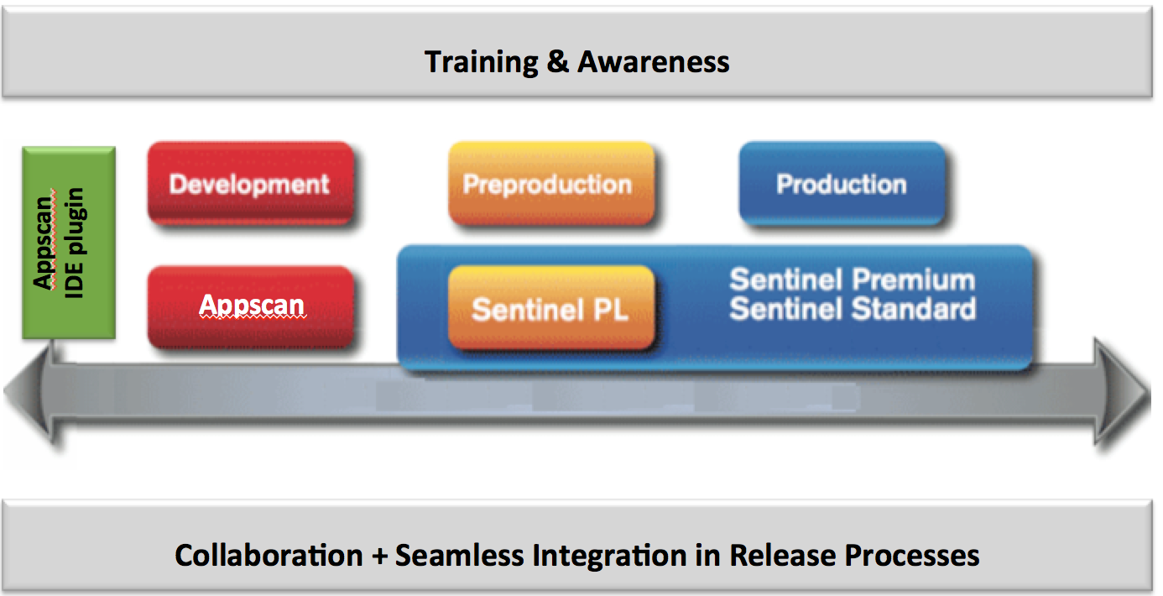


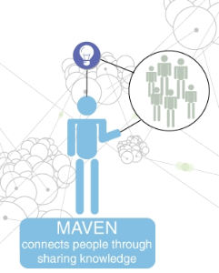
Reporting & Analytics + Engagement
Reporting & Analytics
Data Driven
Visibility and Insights
Product & Infrastructure Quality
Behavior Shift
Seamless Integration
Defect reduction(>90%)
Innovation
Engagement
Mavens

Slide 11
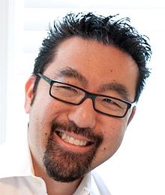

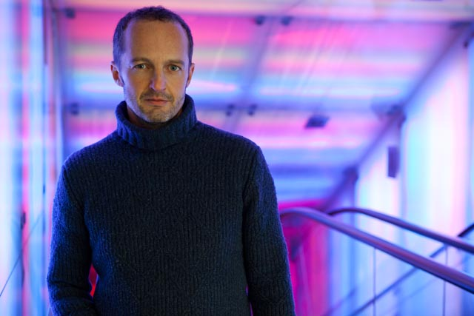
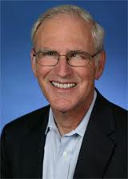
Global Meet ups ..How we integrate with Broader Community
Frequency from once in a month to every week
11

Slide 12
Challenges & Solutions
Culture
Communication
Environments
Tools
Vendors
Distributed Teams
Leaders empowered teams to solve problems
Teams figured out work around with “can do” attitude
Brought core knowledge in-house
Enabled technology for greater collaboration on distributed teams
12

Slide 13
What next?
13

Slide 14
Agile is now our DAY job...it’s now our Culture! InfoSec now is on everyone’s minds
14
Notes:
Product Delivery
Joint Product roadmap and Architecture roadmap
Joint Demos across “silos”
Integrate early
Structure & Communication
Optimal team composition to minimize hand offs for core roles and teams stay intact
Co-location
Transparency: Assessments and information radiators
Culture
Customer focused
Collaborative delivery
Assess and Improve Continuously

Slide 15

Where do I need help?
http://devops.com/wp-content/uploads/2014/09/securityrisk.png
15

